Slide 1
Scenario Development

Slide 2
Scenario Development
Day-in-the-life scenarios
Write scenarios down, act them out
  Particularly important for co-operative interfaces (e.g. Control room)
  Common or rare situations can be represented
  Novice and expert users
  Personas can be used
Example scenario: Microsoft – Health Future Vision
  Seamless integration of I/O into environment, etc.

Slide 3
Example
A grandmother and her 10- and 12-year old grandsons have visited the museum before. They have returned this time to the Learning Center to explore what life was like in her town in Poland in the 1930s. One grandson eagerly touches the buttons on the welcome screen, and they watch the 45-second video introduction by the museum director. They then select the button on "History before the Holocaust" and choose to view a list of towns. Her small town is not on the list, but she identifies the larger nearby city, and they get a brief textual description, a map of the region, and a photograph of the marketplace. They read about the history of the town and view 15-second videos of the marketplace activity and a Yiddish theater production. They bypass descriptions of key buildings and institutions, choosing instead to read biographies of a famous community leader and a poet. Finally, they select "GuestBook" and add their names to the list of people who have indicated an affiliation with this town. Further up on the list, the grandmother notices the name of a childhood friend from whom she has not heard in 60 years-fortunately, the earlier visitor has left an address.
This scenario was written to give nontechnical museum planners and the Board of Directors an idea of what could be built if funding were provided.

Slide 4
User Scenarios
A user scenario is a tool to imagine a user’s journey when using your application.
A good user scenario requires strong research and storytelling to align different teams.
According to the Interaction Design Foundation,
“User scenarios are detailed descriptions of a user – typically a persona – that describe realistic situations relevant to the design of a solution. By painting a ‘rich picture’ of a set of events, teams can appreciate user interactions in context, helping them to understand the practical needs and behaviors of users.”

Slide 5
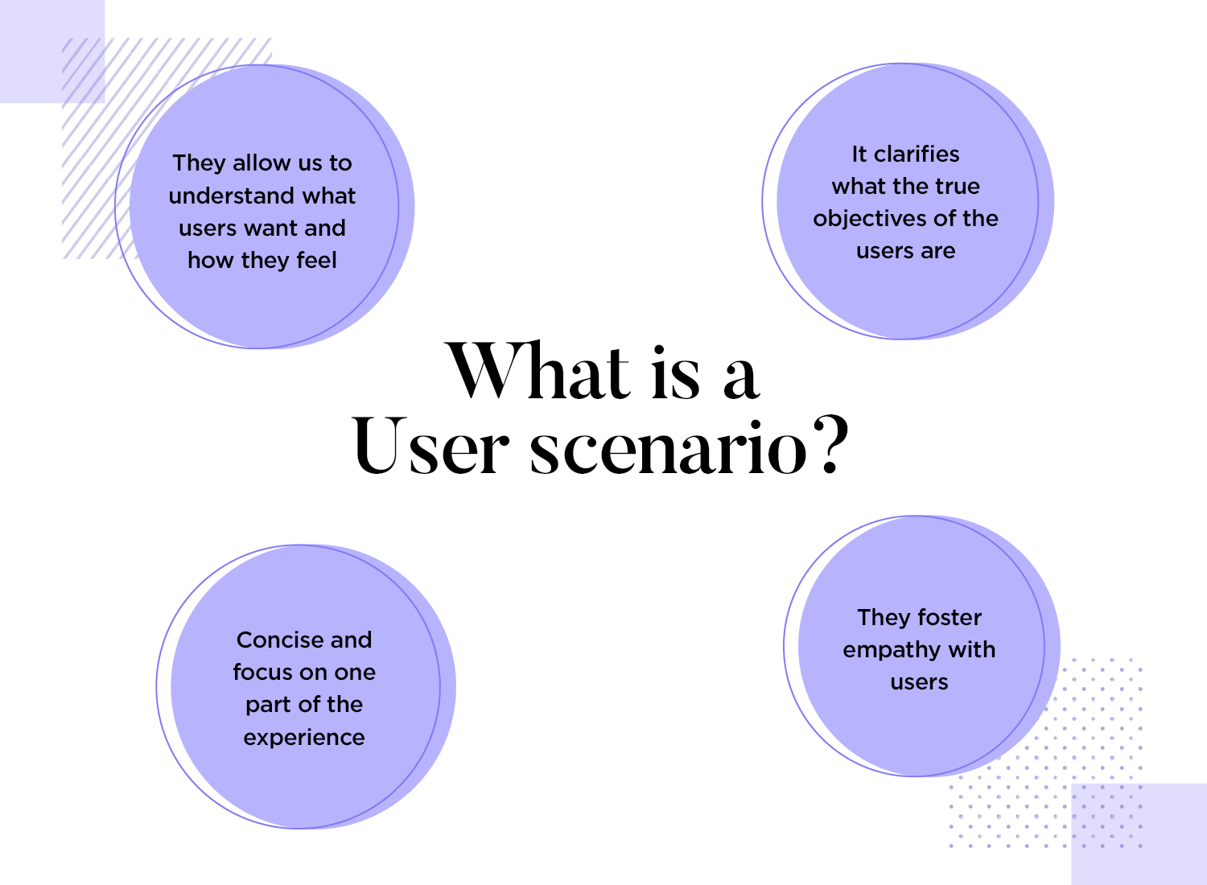
A user scenario is a design process that highlights major ways a user could potentially interact with a product while keeping background information of the user in mind.

Slide 6
Benefits of User Scenarios
Provide us with information about the user's needs and wishes.
Give us the correct context of use.
Take us after the real steps of users when performing a task.
Allow to validate aspects of the design that we could have overlooked.

Slide 7
User scenarios vs. user stories
User stories outline the user and their needs regarding the company's offerings in a concise manner. They focus on the user's perspective and highlight general character traits related to the product.
On the other hand, user scenarios provide more detailed information about a user's persona, how they interact with the product, and the reasons behind their actions. They offer a deeper understanding of the user's journey, including the steps they take to achieve their goals.

Slide 8
User scenario vs. storyboard
After developing a user scenario, a storyboard visually represents how the user interacts with your site or app.
Illustrations, sketches, screenshots, slideshows, and animated demos are different storyboard types UX professionals use.
User scenarios and storyboards work together to identify key user information and improve or create new products or features that continue delighting users.

Slide 9
Example
User story from Sam: “I want to invite my students to teach them on this platform.”
User scenario:
Sam has just logged into his teacher portal after waiting in morning traffic for 40 minutes. His coffee is getting cold, and he just wants his teaching platform set up before the school day starts.
As he takes his first sip of coffee, he realizes he still needs to invite the students. He rushes to figure out the system, texting his fellow teacher down the hall to see if they know how it works.
Before they can reply, Sam sees the “invite your students” call-to-action button and presses it. He sees a clear list of his students, the ability to “select all,” and the “invite” option, which he clicks.
Sam finishes sipping his coffee as he watches his students arrive in his virtual teacher portal.

Slide 10
What to include in your user scenario
Context: Describe the situation and steps your user takes to arrive at your product/service
Goals: What do they want to achieve?
Problems: What are they trying to solve and what obstacles do they encounter?
Motivations: Why do they need or want your offering?
Personal traits: Provide background to paint a more detailed picture
Relevant habits, hobbies and/or beliefs: Actions and emotions that occur in relation to your product/service add a layer of context
Demographics: Relevant info about location, income, occupation, marital status, etc.

Slide 11
Renting a car for a business trip user scenario example
Shivani is a Marketing Manager in Chennai, and she has a business trip coming up in Shimla. The trip is half pleasure, half work, and she wants to do some hiking in the mountain trails. She knows the roads can be pretty bumpy, so she wants to rent a car that is suitable for off-road driving. Shivani discovers our website to find the perfect car. She is unfamiliar with these types of vehicles, so she compares some models and reads the reviews to get a better idea of her best option. When she finds one she likes in the budget allotted by her company, she books it.

Slide 12
Travel user scenario example
Jane is a college student planning a spring break beach trip to Florida. She searches online for the top Florida spring break destinations and pricing to determine where fits her budget.
After settling on the destination, she wonders if she can easily compare hotel prices in one place. She remembers her friend telling her about a travel website.
Jane finds the website, finds her ideal hotel, and books her stay by following the website's booking process.

Slide 13
Bank loan payment user scenario example
Mr. and Mrs. Smith recently moved to a new house closer to their out-of-state family. They receive mailed statements for their loans to make the necessary payments from their local bank and know they must notify them of their move.
Unfortunately, they are unsure of the closest bank, and walking or driving far is difficult for the aging couple. It seems viable to use their computer to make an address change with their bank and make upcoming payments.
However, they feel uneasy about the safety of providing personal details online. Since they have never visited the bank’s website, they are unfamiliar with its layout and how to access their accounts.
Therefore, they want to learn how safe it is to provide their address change request and make online payments.

Slide 14
Personas
A persona is a fictional character which represents certain traits and qualities of real users.
Personas are an important tool for understanding and empathising with your target audience.
Personas are usually captured in a document or presentation deck, providing an easily digestible visualisation of your target user(s).
Personas comprise a mixture of text and icons/graphics and you can also give them a face.

Slide 15
Personas
Pesona includes:
  The persona’s name
  An image (e.g. an illustration, avatar, photo or stock image)
  Demographic information such as your persona’s age, gender, family/living situation, employment status and anything else that’s relevant to your product or problem space
  Their needs and goals in relation to your product
  A summary of their challenges, frustrations and pain points in relation to your product or problem space
  Quotes from real users whom the persona should represent

Slide 16
Why do you need a persona?
A persona clarifies who is in your target audience by answering the following questions:
  Who is my ideal customer?
  What are the current behavior patterns of my users?
  What are the needs and goals of my users?
  What issues and pain points do they currently face within the given context?

Slide 17
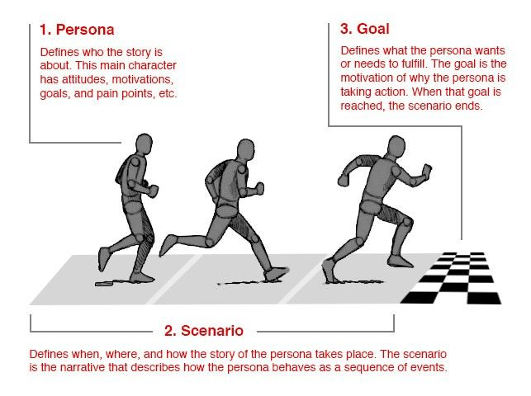

Slide 18
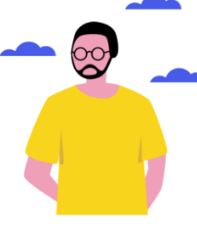
Example of Persona
Fictional Name
  Michael Johnson
Occupation
  Self-employed, owns a coffee shop in the city center
Demographics
  30 years old;
  Lives in Chennai, India;
  Married, no children;
  Has two brothers;
  Takes care of his father after a stroke, helps him out financially;
  Has an upper-middle-income level & a profitable business.

Slide 19
Example of Persona
Goals and Needs
  As a busy person, Michael doesn’t like wasting time, as time is money for him. So, he needs to make payments on-the-go and have access to most banking services like generating banking documents, applying for loans, etc.
  Being a business owner, he needs to keep his business banking account and a personal one separate. Simultaneously, Michael wants to use both accounts easily and switch between them with no effort.
Pain Points
  Switching between different accounts takes too many actions on Michael’s behalf. He would prefer to do it in one click. Besides, he still needs to go to a bank for the services that could be available online.

Slide 20
Example of Persona
Relevant Patterns of Behavior
  The man spends the biggest part of the day (5+ hours) on the smartphone making calls, negotiating, or messaging. He is tech-savvy and uses the latest iPhone. Michael’s phone is full of apps, as he prefers them to mobile versions of websites. The man knows his way around an app in a matter of seconds, so he always skips tutorials.
Personality
  “I hate queues in banks. That’s why I use online banking – it’s a lot less nerve-racking and much faster.”

